Slide 1

HR Analysis Report:
Insights & Strategic Recommendations
Dinesh M | Date: January 2026

Slide 2
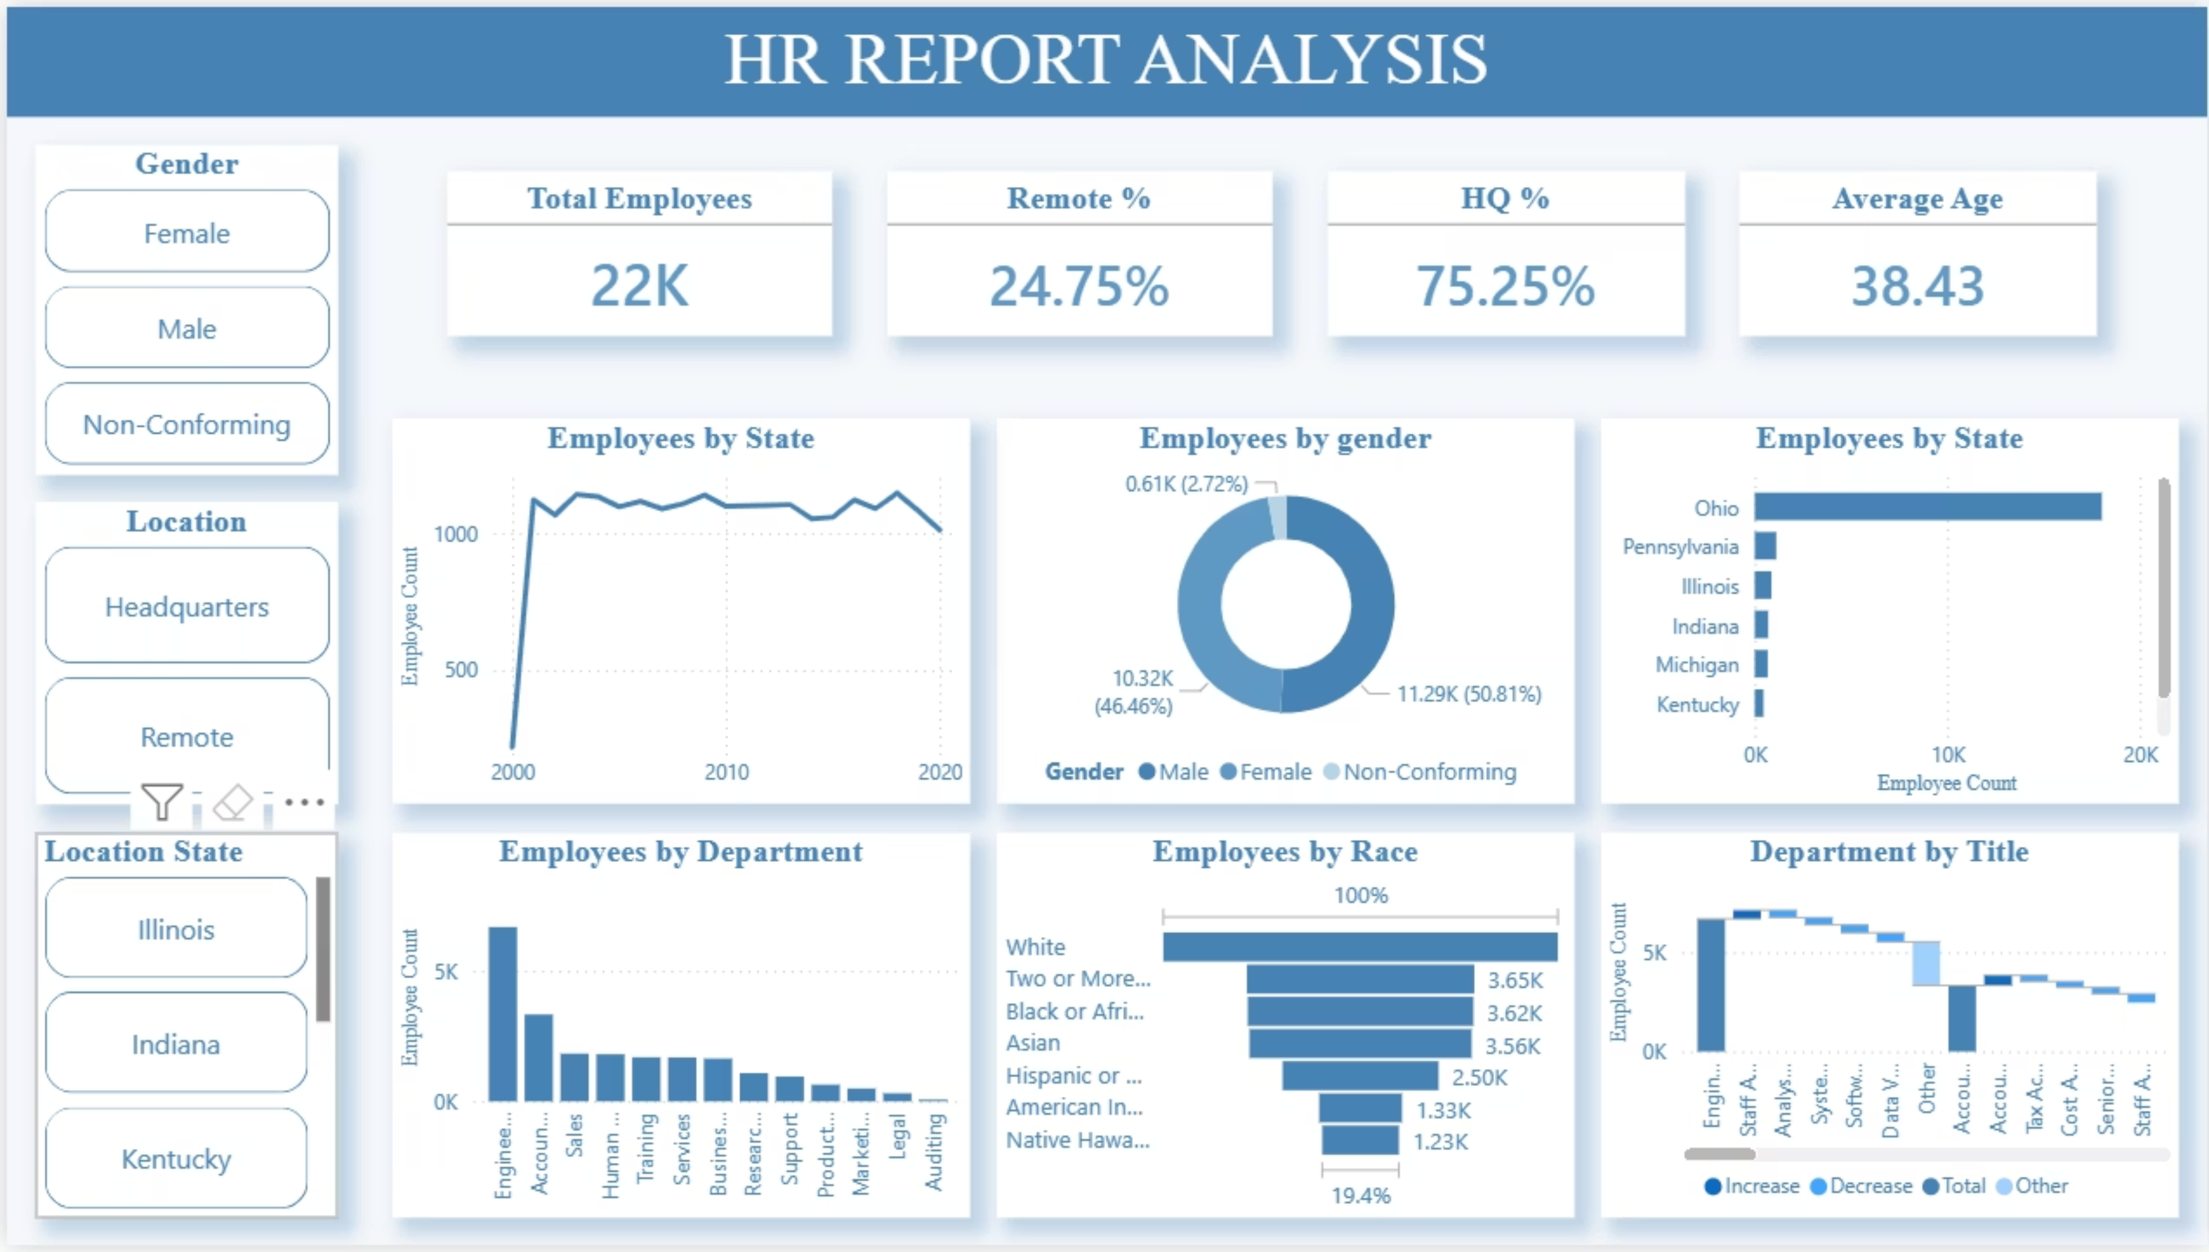

Slide 3
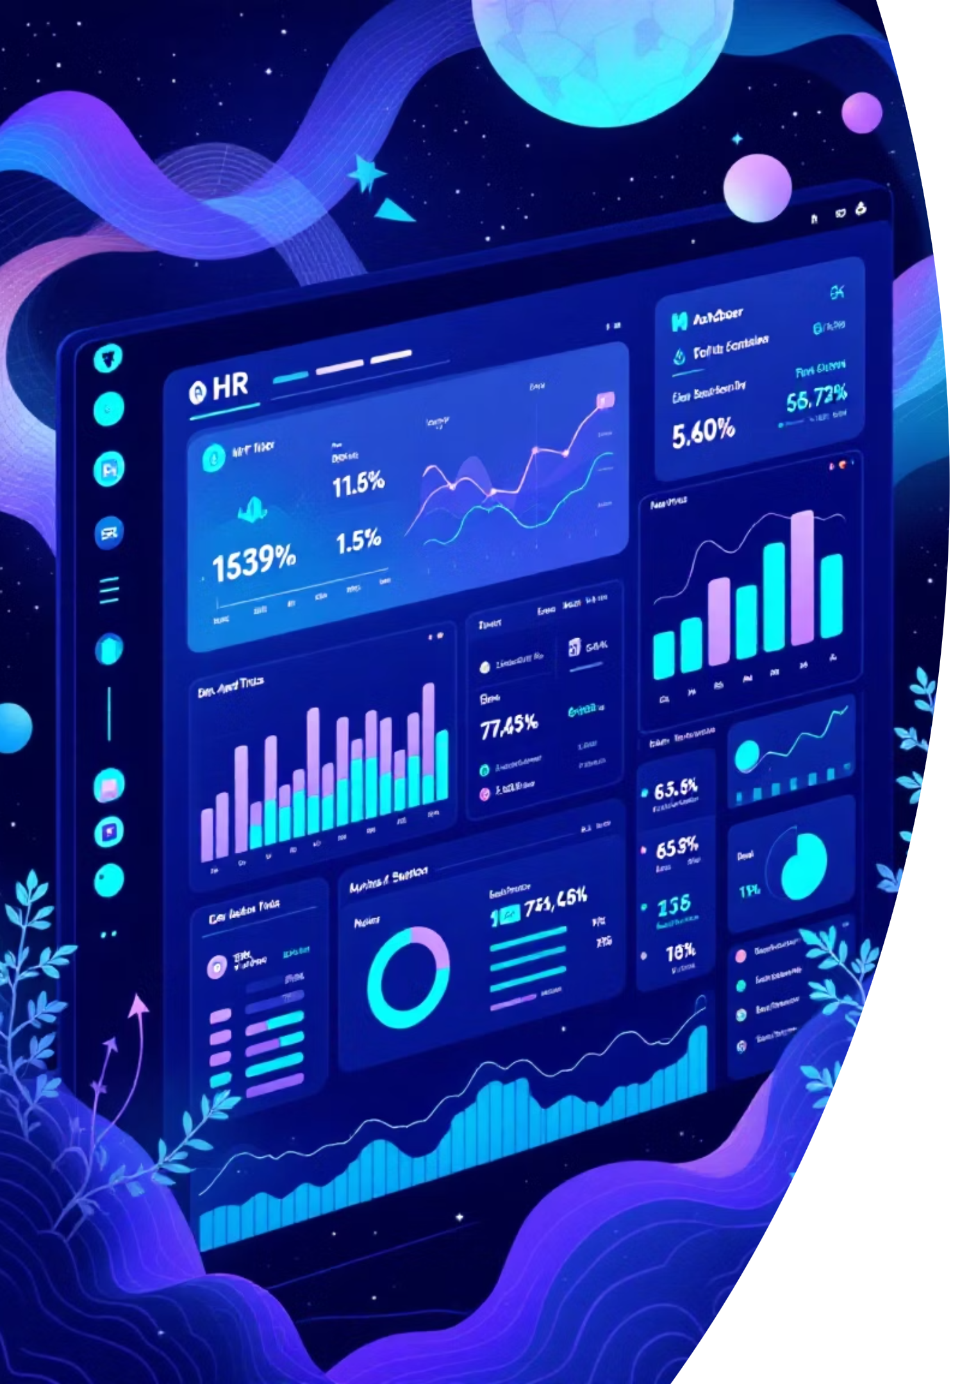
KPI Dashboard: A Snapshot of Our Workforce
22,214
38.52
Total Employees
Average Age
Our global team continues to grow, reflecting our expanding operations.
A balanced mix of experience and fresh perspectives across the organization.
24.65%
75.35%
Remote Workforce
Headquarters-Based
A significant portion of our employees benefit from flexible work arrangements.
The majority of our talent remains concentrated at our primary locations.
This snapshot highlights key characteristics, indicating opportunities for both location and age-based talent strategies. Understanding these metrics is crucial for targeted HR initiatives.

Slide 4
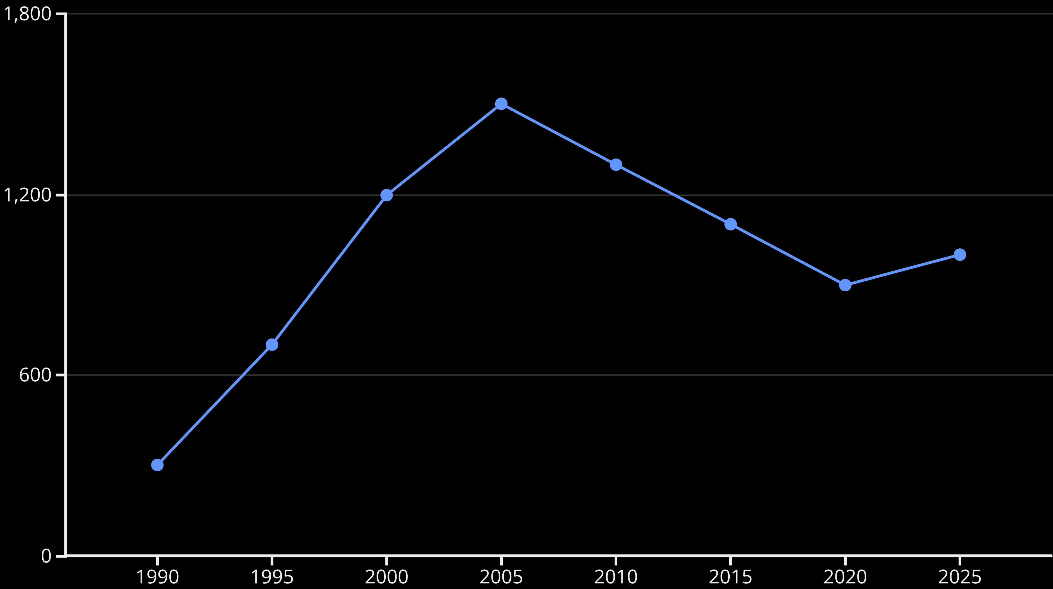
Hiring Trend Analysis: Sustained Growth & Talent Investment
The line chart illustrates a significant hiring surge in the early 2000s to 2010s, indicative of a rapid growth phase. We have consistently maintained a strong hiring pipeline, bringing in over 1,000 new employees annually, showcasing sustained talent investment.

Slide 5
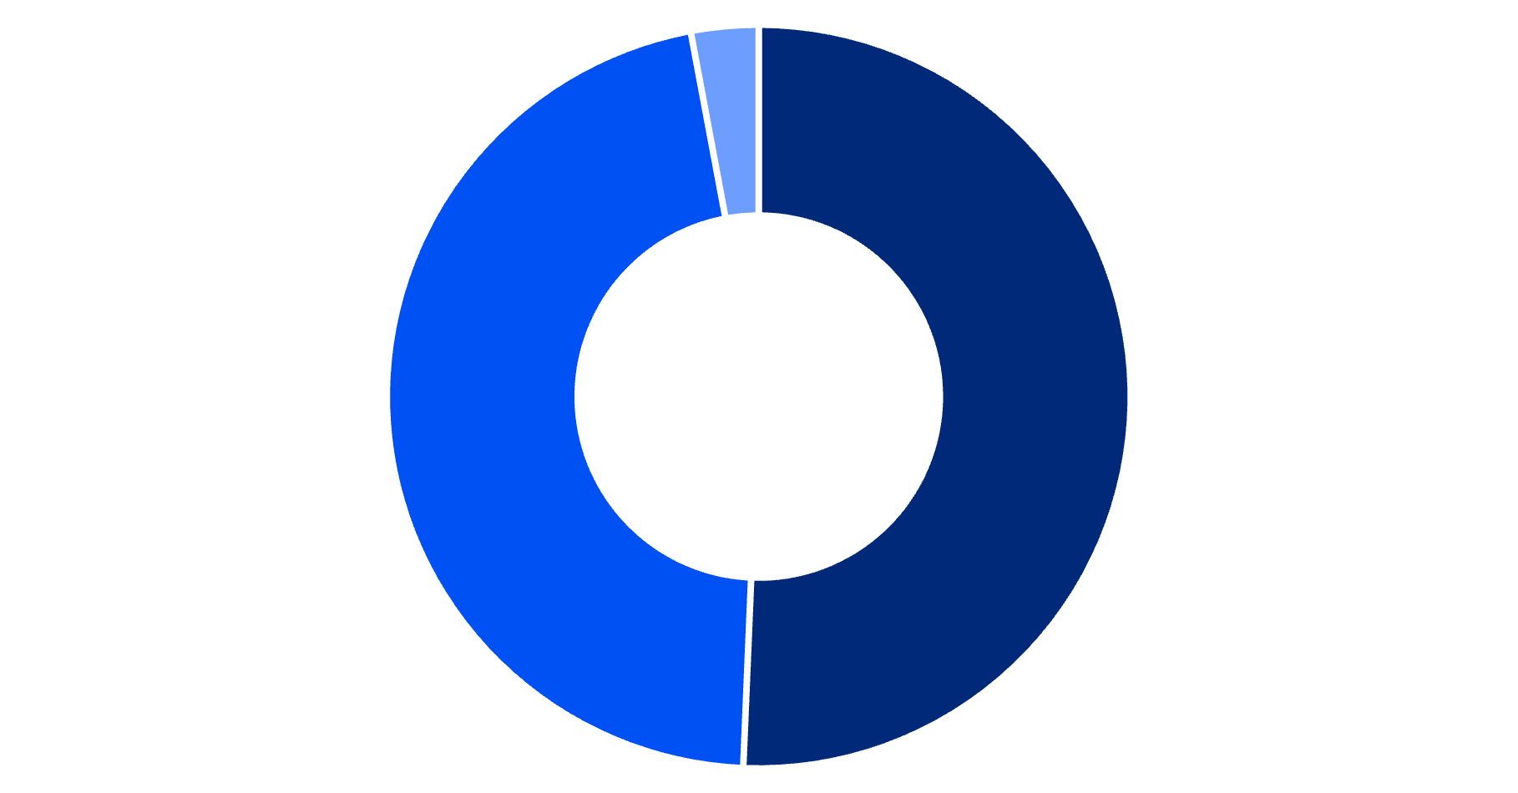
Gender & Diversity Overview: Balanced Representation
Key Insight:
Our workforce demonstrates nearly balanced gender representation, a significant competitive advantage that fosters diverse perspectives and innovation.
Strategic Recommendation:
Conduct a deeper audit of gender representation across seniority levels and specific departments to ensure equity and identify areas for targeted development.
Male
Female
Non-Conforming

Slide 6
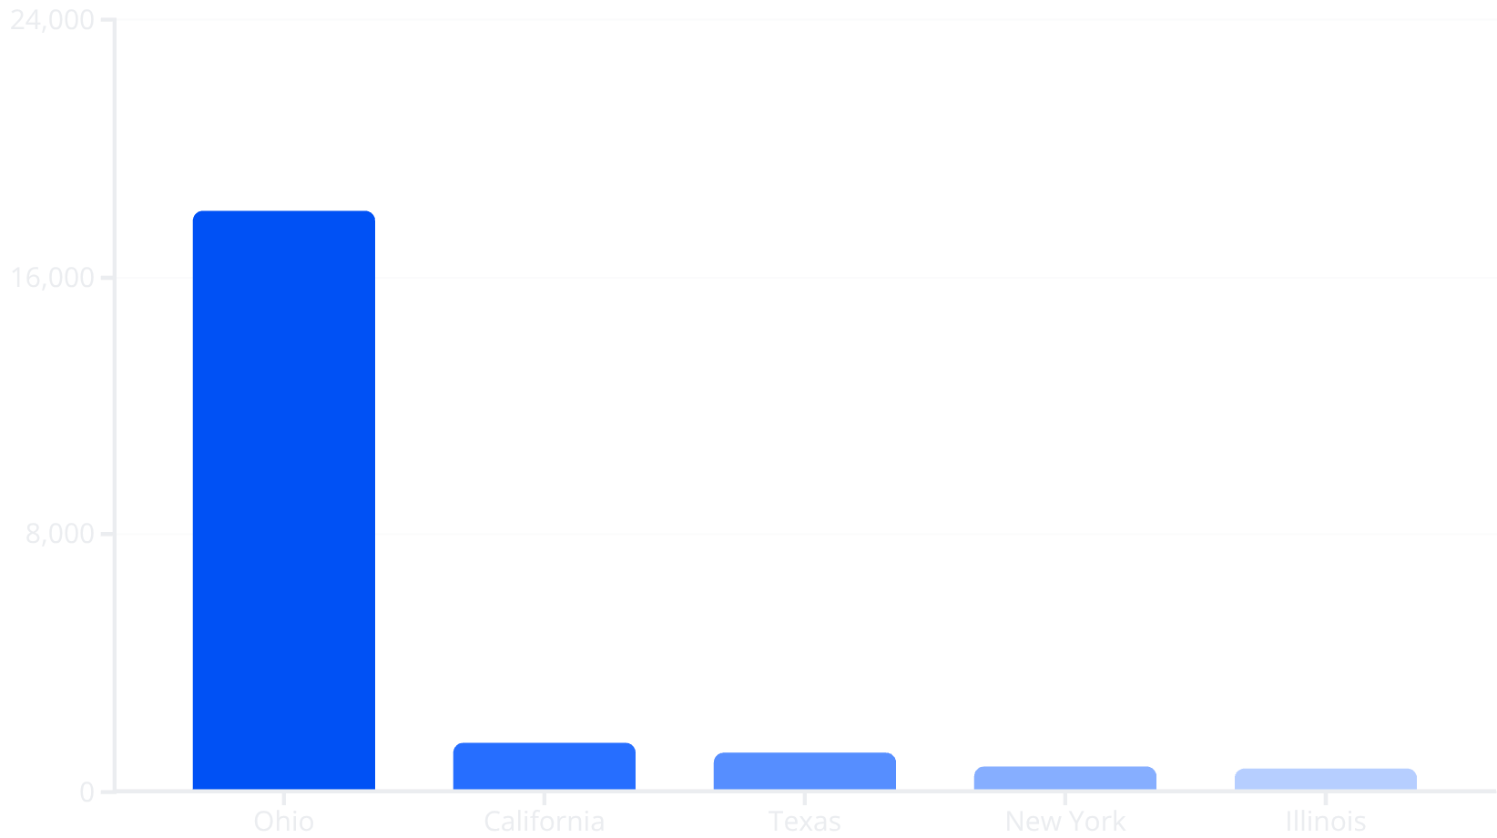
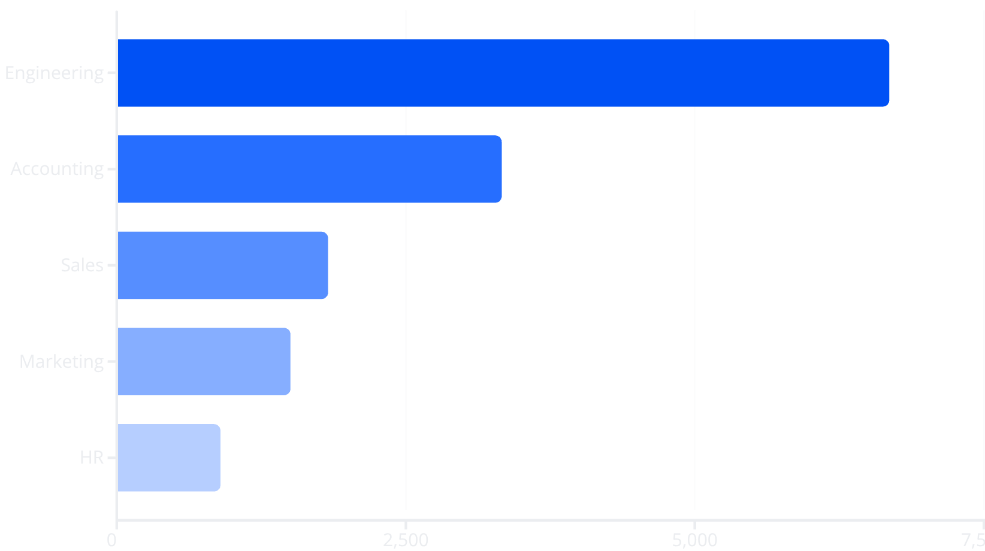
Geographic & Departmental Distribution
Our workforce concentration reveals key operational hubs and strategic talent centers.
Employees by State
Employees by Department
Ohio remains our primary talent hub, indicating a significant geographical concentration.
Engineering is our largest department, highlighting our focus on technical innovation.

Slide 7
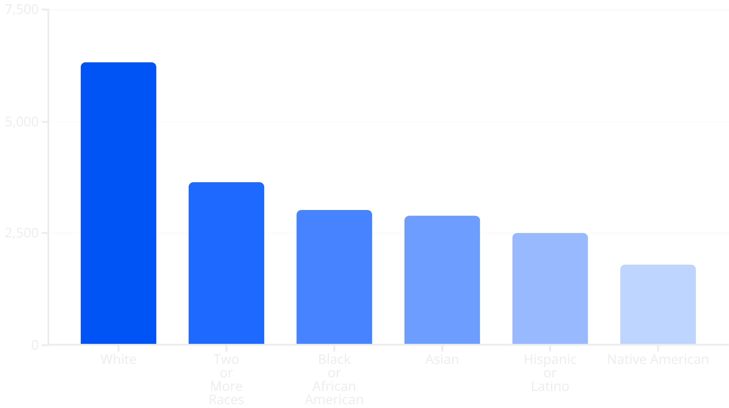
Racial Diversity Analysis: Fostering an Inclusive Environment
Key Insight:
Our organization boasts a diverse workforce with broad representation across various racial and ethnic backgrounds.
Action Item:
Continuously monitor representation equity across all departments and leadership levels to ensure fair opportunities and an inclusive culture for everyone.

Slide 8

Key Insights & Strategic Findings: Shaping Our Future Workforce
Workforce Concentration Risk
High employee density in Ohio suggests potential vulnerability to regional economic shifts or talent market changes.
Engineering-Driven Organization
The large Engineering department indicates a strong focus on innovation and product development.
Strong Diversity
Commendable gender balance and racial diversity provide a strong foundation for an inclusive culture.
Aging Workforce
An average age of 38.5 years highlights the critical need for proactive succession planning and knowledge transfer strategies.
Remote Work Opportunity
With ~25% remote employees, there's significant room to expand remote adoption, fostering flexibility and accessing broader talent pools.

